Slide 1
Scientific Programming
Artificial Intelligence
Ankara University
Computer Engineering

Slide 2
Content
What is Artificial Intelligence?
Intelligent Agent Concept
Search Algorithms

Slide 3
What is Artificial Intelligence?
Artificial Intelligence as a Program or System
Irrigation
Site Lighting
Backgammon or chess program
Auto parked vehicle
Problem solving
Even a simple calculator can be thought of as an artificial intelligence application.

Slide 4
What is Artificial Intelligence?
Do we want to design a system that behaves like a human? or are we dreaming of a system that acts rationally?
Thinking Like Human
How he models problems, how he makes inferences
Behaving Like a Human
The ability of a system to imitate a human
Man is not always rational
They have intuitive situations, can act with their feelings, seek adventure
They have feelings, they have dreams, they have traumas
Turing Test
You communicate with 2 objects (1 human, 1 artificial intelligence)
If artificial intelligence demonstrates that it behaves like a human and defeats its opponent, it is assumed to pass the Turing test.

Slide 5
Artificial Intelligence Approaches
Thinking Rationally
Use of Logic
Acting rationally
Maximizing the expected benefit
Examples:
Robot vacuum cleaner: cleaning the whole house as soon as possible
Man may not always act rationally.
Home cleaning by singing or listening to music

Slide 6
Artificial Intelligence Approaches
How is information kept?
How is information kept in humans and how is it represented in computer systems?
Years of experience
Color information, car information, date information
If we ask someone what color was Aristo's car
Let's ask the same question to Google
Very unrelated answers

Slide 7
Artificial Intelligence Approaches
Deep Blue defeating Kasparov in 1997
Proverb program solving crossword puzzles better than humans

Slide 8
Intelligent Agent Concept
Has communication with the environment
It has an internal system
It updates its knowledge by combining the information it receives from the environment with the information available in its internal system.
Biological systems, creatures (Humans, animals)
Software agents (Virus programs, Search engines)
Robots (Vacuum Cleaner)
Our goal is to create intelligent agents

Slide 9
Intelligent Agent Concept
Robots (Vacuum Cleaner)
Rational performance criteria
Completion in a certain time
Low electricity consumption
Cleaning the environment
Little noise generation
Run autonomously
It can adapt to the environment through the information it receives from its sensors

Slide 10
Intelligent Agent Concept
Automatic Taxi Driver
Defining performance
Providing the customer with a safe, fast, comfortable and legal journey, maximizing the amount of profit to be obtained.
Environment
Roads, other vehicles, pedestrians and customers
Actuators
Steering, accelerator, brake, signal and horn
Sensors
Cameras, sonar, speedometer, GPS, odometer, engine sensors, keyboard

Slide 11
SEARCH ALGORITHMS
Can a real-life problem be turned into a search problem?
The Search Problem consists of the following elements:
State Space
Successor Function (transaction and transaction cost)
Initial Condition
Final State (Solution)
A solution: Sequential execution of operations from the initial state to the final state

Slide 12
SEARCH ALGORITHMS
Example: 8 puzzle
Successor Function: The empty cell moves left, right, up or down.
Cost: Each movement of the empty cell costs 1 unit.
8 | 5 | 2
6 |  | 1
4 | 7 | 3
 | 1 | 2
3 | 4 | 5
6 | 7 | 8
Initial state
Solution

Slide 13
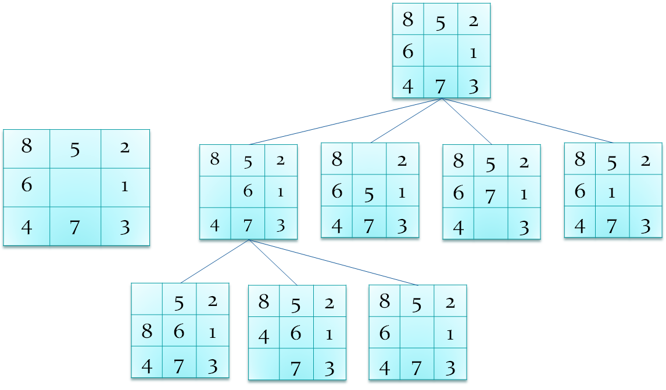
SEARCH ALGORITHMS
Example: 8 puzzle
Initial State

Slide 14
SEARCH ALGORITHMS
Example:
Initial Condition: We are in city A
Objective Status: We want to be in the city G (Which cities we reach through)
Successor Function: Moving from a city to neighboring cities
Cost: Each route has different costs. (Time, Fuel Used, km)
G
A
C
E
D
H
B
F

Slide 15
SEARCH ALGORITHMS
Example:
G
A
A
C
E
D
H
B
F
B
D
C
A
D
F
A
B
E
F
A
E
F
B
D
C
C
G
D
H

Slide 16
SEARCH ALGORITHMS
Breadth First Search
Uniform Cost Search
Depth First Search
Depth Limited Search
Iterative Deeping Search

Slide 17
SEARCH ALGORITHMS
Breadth First Search
The following tree represents the
possible search space. It is not breadth first tree!
Repeated nodes will not be placed on actual tree.
G
A
C
E
A
D
H
B
F
B
D
C
A
D
F
A
B
E
F
A
E
F
B
D
C
C
G
D
H

Slide 18
SEARCH ALGORITHMS
Uniform Cost Search
The following tree represents the
possible search space. It is not uniform cost tree!
Repeated nodes will not be placed on actual tree.
G
A
C
E
A
D
H
B
F
B
D
C
A
D
F
A
B
E
F
A
E
F
B
D
C
C
G
D
H

Slide 19
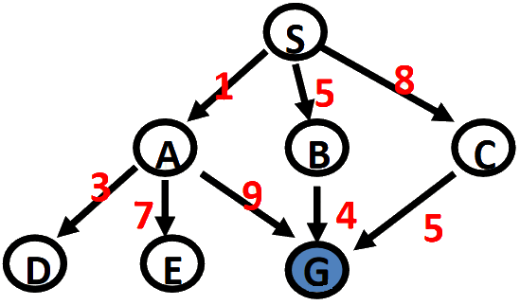
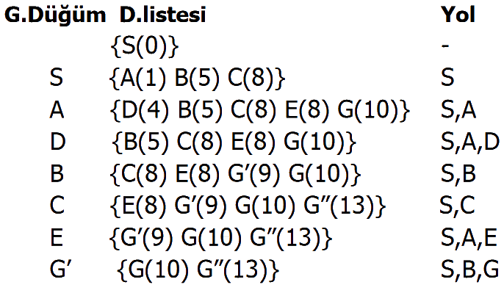
SEARCH ALGORITHMS

Slide 20
SEARCH ALGORITHMS
Depth First Search
The following tree represents the
possible search space. It is not depth first tree!
Repeated nodes will not be placed on actual tree.
G
A
C
E
D
A
H
B
F
B
D
C
A
D
F
A
B
E
F
A
E
F
B
D
C
C
G
D
H

Slide 21
SEARCH ALGORITHMS
Depth Limited Search
The following tree represents the
possible search space. It is not depth limited tree!
Repeated nodes will not be placed on actual tree.
G
A
C
E
A
D
H
B
F
B
D
C
A
D
F
A
B
E
F
A
E
F
B
D
C
C
G
D
H

Slide 22
SEARCH ALGORITHMS
Iterative Deepening Search
The following tree represents the
possible search space. It is not iterative deepening
tree! Repeated nodes will not be placed on actual
tree.
G
A
C
E
A
D
H
B
F
B
D
C
A
D
F
A
B
E
F
A
E
F
B
D
C
C
G
D
H

Slide 23
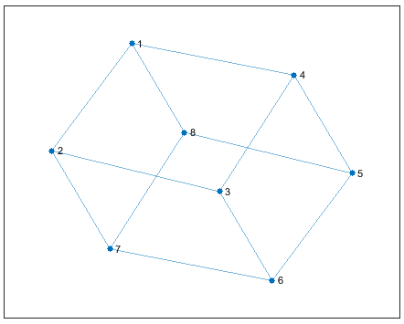
SEARCH ALGORITHMS - MATLAB
G = graph (s, t) (s, t) creates a graph with edges between node pairs.
G = graph (s, t, weights) where the values in the weights array specify the edge weights. Creates a graph with edges between (s, t) node pairs.
s = [1 1 1 2 2 3 3 4 5 5 6 7];
t = [2 4 8 3 7 4 6 5 6 8 7 8];
G = graph(s,t)
plot(G)

Slide 24
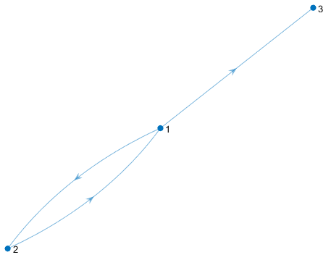
SEARCH ALGORITHMS - MATLAB
G = digraph(s,t)
G = digraph(s,t,weights)
G = digraph([1 1 2],[2 3 1])
plot(G)

Slide 25
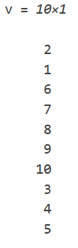
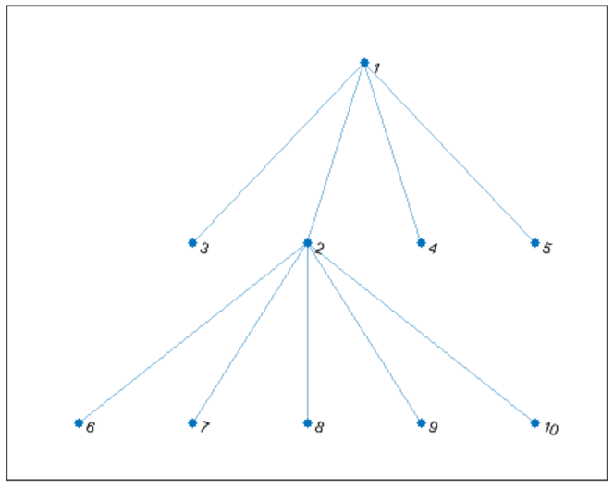
SEARCH ALGORITHMS - MATLAB
v = bfsearch(G,s) command applies the breadth-first search algorithm to graph G, starting at node s.
s = [1 1 1 1 2 2 2 2 2];
t = [3 5 4 2 6 10 7 9 8];
G = graph(s,t);
plot(G)
v = bfsearch(G,2)

Slide 26
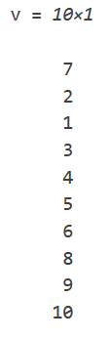
SEARCH ALGORITHMS - MATLAB
v = dfsearch(G,s) command applies depth-first search algorithm to graph G, starting from node s.
s = [1 1 1 1 2 2 2 2 2];
t = [3 5 4 2 6 10 7 9 8];
G = graph(s,t);
plot(G)
v = dfsearch(G,7)

